Slide 1

Rude vs. Mean vs. Bullying
Because everything isn’t bullying!!!

Slide 2
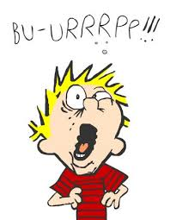
Rude
Accidentally saying or doing something
that hurts feelings or embarrasses someone
Also inconsiderate thoughtless, unplanned behavior, bad manners, only thinking about yourself, not meant to actually hurt anyone
EXAMPLES: Burping, coughing, sneezing on others, bragging about the highest grade, cutting in line, horseplay, being disrespectful, getting in personal space

Slide 3

Mean
Saying or doing something on purpose to hurt someone maybe once or twice
Sometimes said in anger to make someone else look bad, we usually feel regret later
EXAMPLES: criticizing or making fun someone’s clothes, looks, intelligence, skin, language, breaking or stealing others belongings

Slide 4
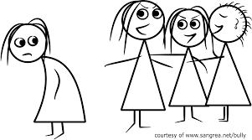
Bullying
Behavior that is on purpose, repeated over time and involves and imbalance of power
3 types of bullying:
Physical: actions that hurt your body
Verbal: words that hurt your feelings
Cyberbullying: intentional, repeated harmful behavior using technology

Slide 5

BRAINSTORM!!!
Work with your table to think of all the things you can that fit in each category

Slide 6
Review
Rude: Inconsiderate, thoughtless, unplanned behavior, bad manners, only thinking about yourself, not meant to actually hurt anyone
Mean: Saying or doing something on purpose to hurt someone, maybe once or twice, usually in anger
Bully: on purpose, repeated over time and involves and imbalance of power

Slide 7
Resources
Whitson, Signe,
http://www.huffingtonpost.com/signe-whitson/bullying_b_2188819.html
http://signewhitson.com
This PowerPoint created by: http://exploringschoolcounseling.blogspot.com

